Slide 1

HBase, Kafka & Bloom Filters:
Week 10
Marilson Campos
UCSC Extension - 2022

Slide 2
1 - HBase – Hadoop Database
HBase allows us to extend the concept of ‘table’ that
Hive provides us.
It allows:
- Single field updates.
- Hold multiple versions each field.
- Large scale concurrent writes.
- “Irregular” database schema.
Reference: HBase: The Definitive Guide (O’Reilly)

Slide 3

1 - HBase – Hadoop Database
HBase extends the abstraction of a Hive ‘table’.
It allows:
- Single field updates.
- Hold multiple versions each field.
- Large scale concurrent writes.
- “Irregular” database schema.
Reference:
HBase: The Definitive Guide
(O’Reilly)

Slide 4
HBase – API
void delete(Delete delete)
Deletes the specified cells/row.
boolean exists(Get get)
Using this method, you can test the existence of
columns in the table, as specified by Get.
Result get(Get get)
Retrieves certain cells from a given row.
void put(Put put)
Using this method, you can insert data into the table.
scan(table)
Scans the table in sequence reading ALL data.

Slide 5
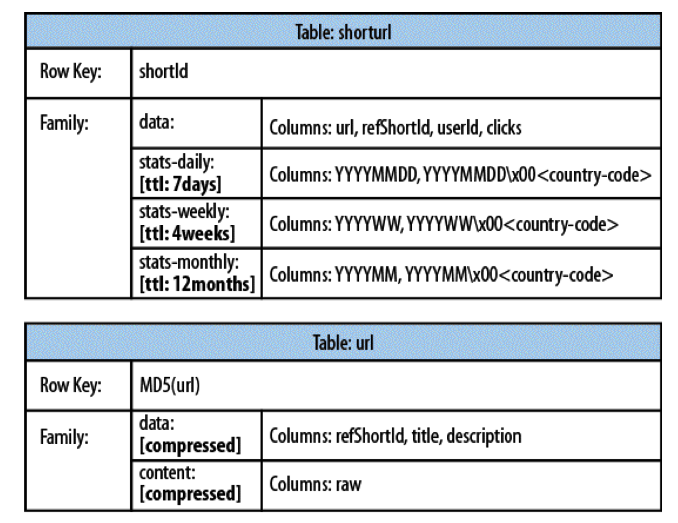
HBase – HBase tables

Slide 6
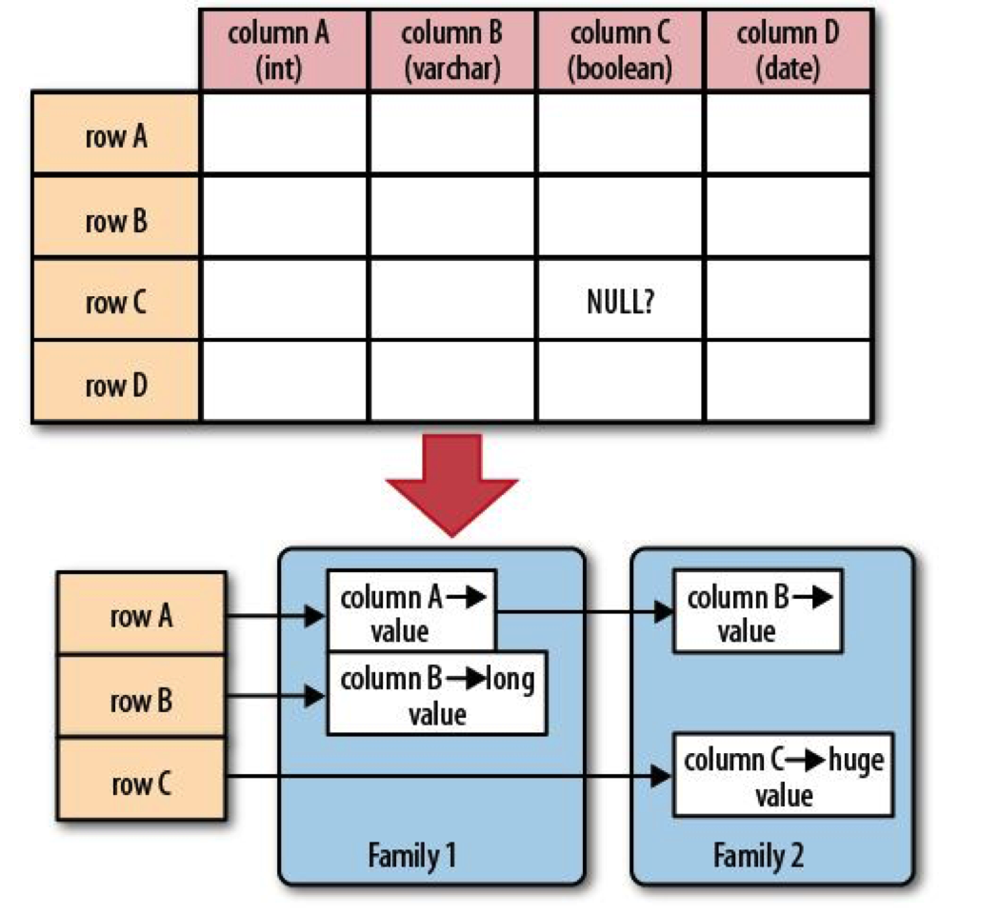
HBase – Tables in regions

Slide 7
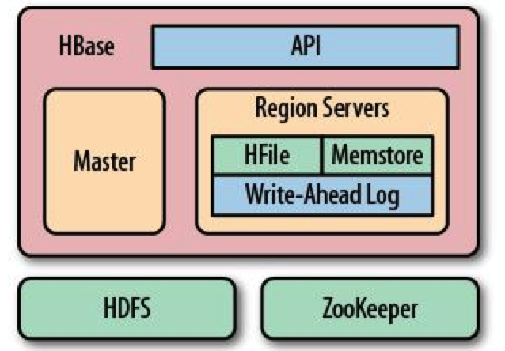
HBase – Components

Slide 8
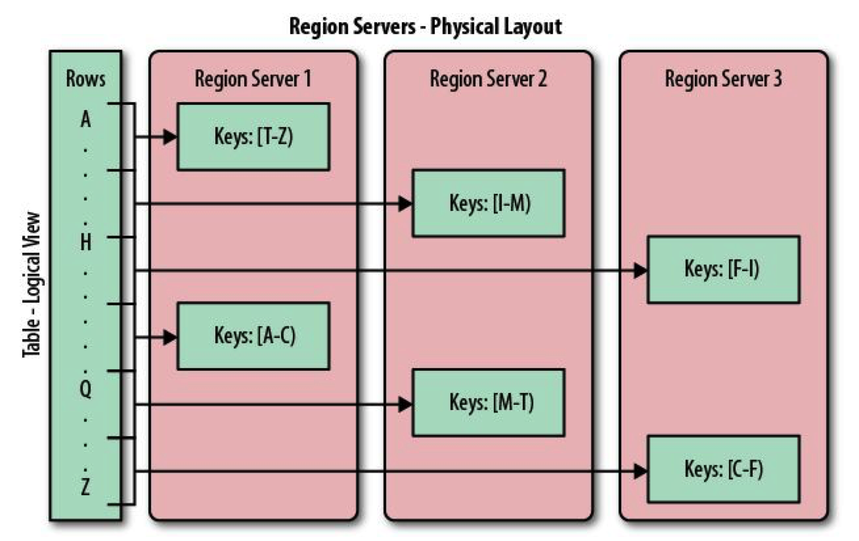
HBase – Physical layout

Slide 9
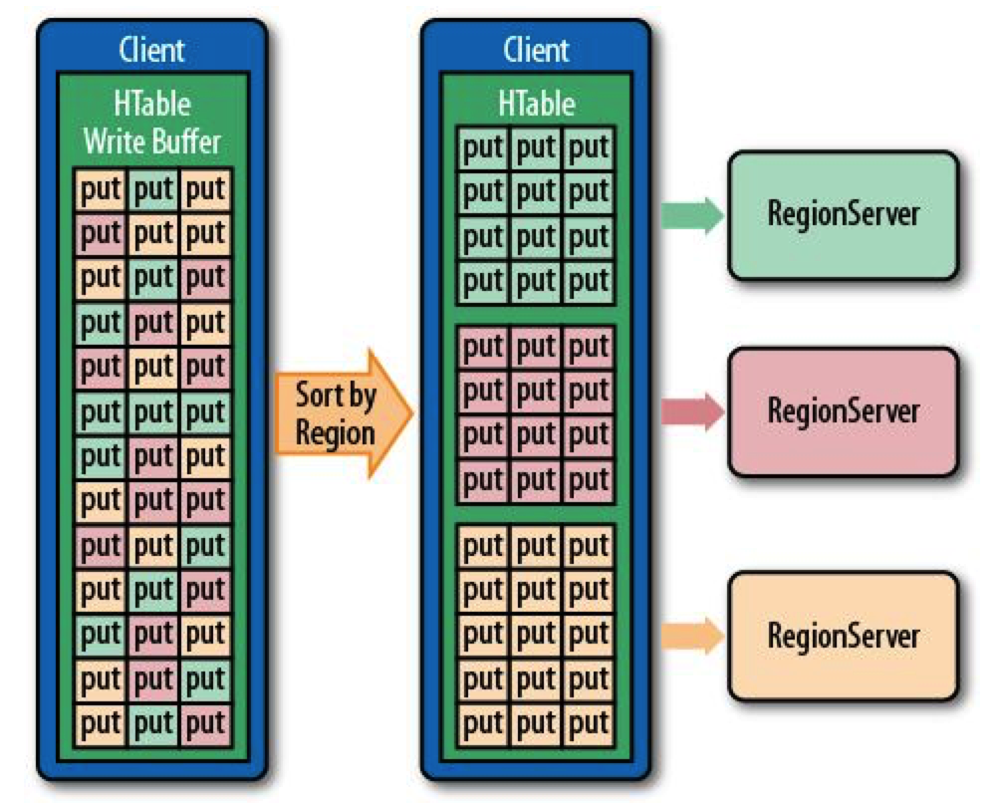
HBase – Writing

Slide 10
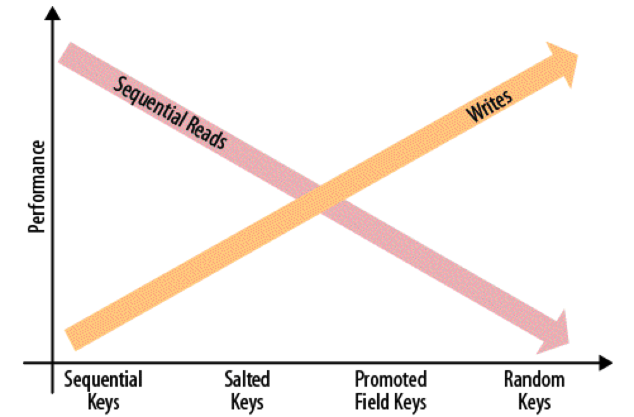
HBase – IO Performance

Slide 11
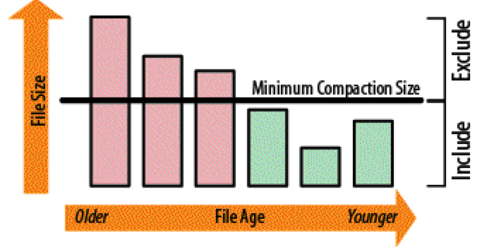
HBase – Compaction
Compaction is the mechanism that HBase uses to remove old records and deleted records.
Operations are based on key + timestamp

Slide 12

2 – Real time streaming
- Flexible Publish-subscribe/queue
- Robust Replication
- Ordering Preserved at topic partition level

Slide 13
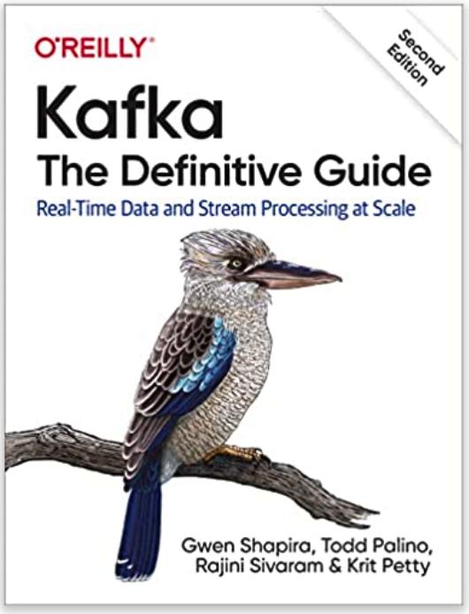
2 – Real time streaming
Recommended reference
The second edition of the original reference
created by the team at Confluent.io

Slide 14
2 – Kafka Marketplace
Apache Kafka – open source
Confluent.io – Apache Kafka as a Service
Amazon MKS – Amazon Apache Kafka as a service

Slide 15
2 – Real time streaming
Use cases
1. Process events in real-time.
2. Most often you need to capture them in real-time
and have the option to analyze some of these events in real-time.
Examples of event sources:
IOT Sensors
Microservice calls
Http calls
etc.

Slide 16
2 – Real time streaming
Realtime Consumers
Spark Streaming
Storm
Apache Flink
Kinesis
Kinesis / Analytics
Batch consumers
Hadoop HDFS
Aws S3
HBase
Cassandra

Slide 17
2 – Decoupling from consumer and producers.
- Producers can write faster than consumers for some time.
- Writes rate cannot be higher for long time or we run out of space.
- Kafka acts like a reliable system to capture events and deliver them some time later to multiple consumers.

Slide 18
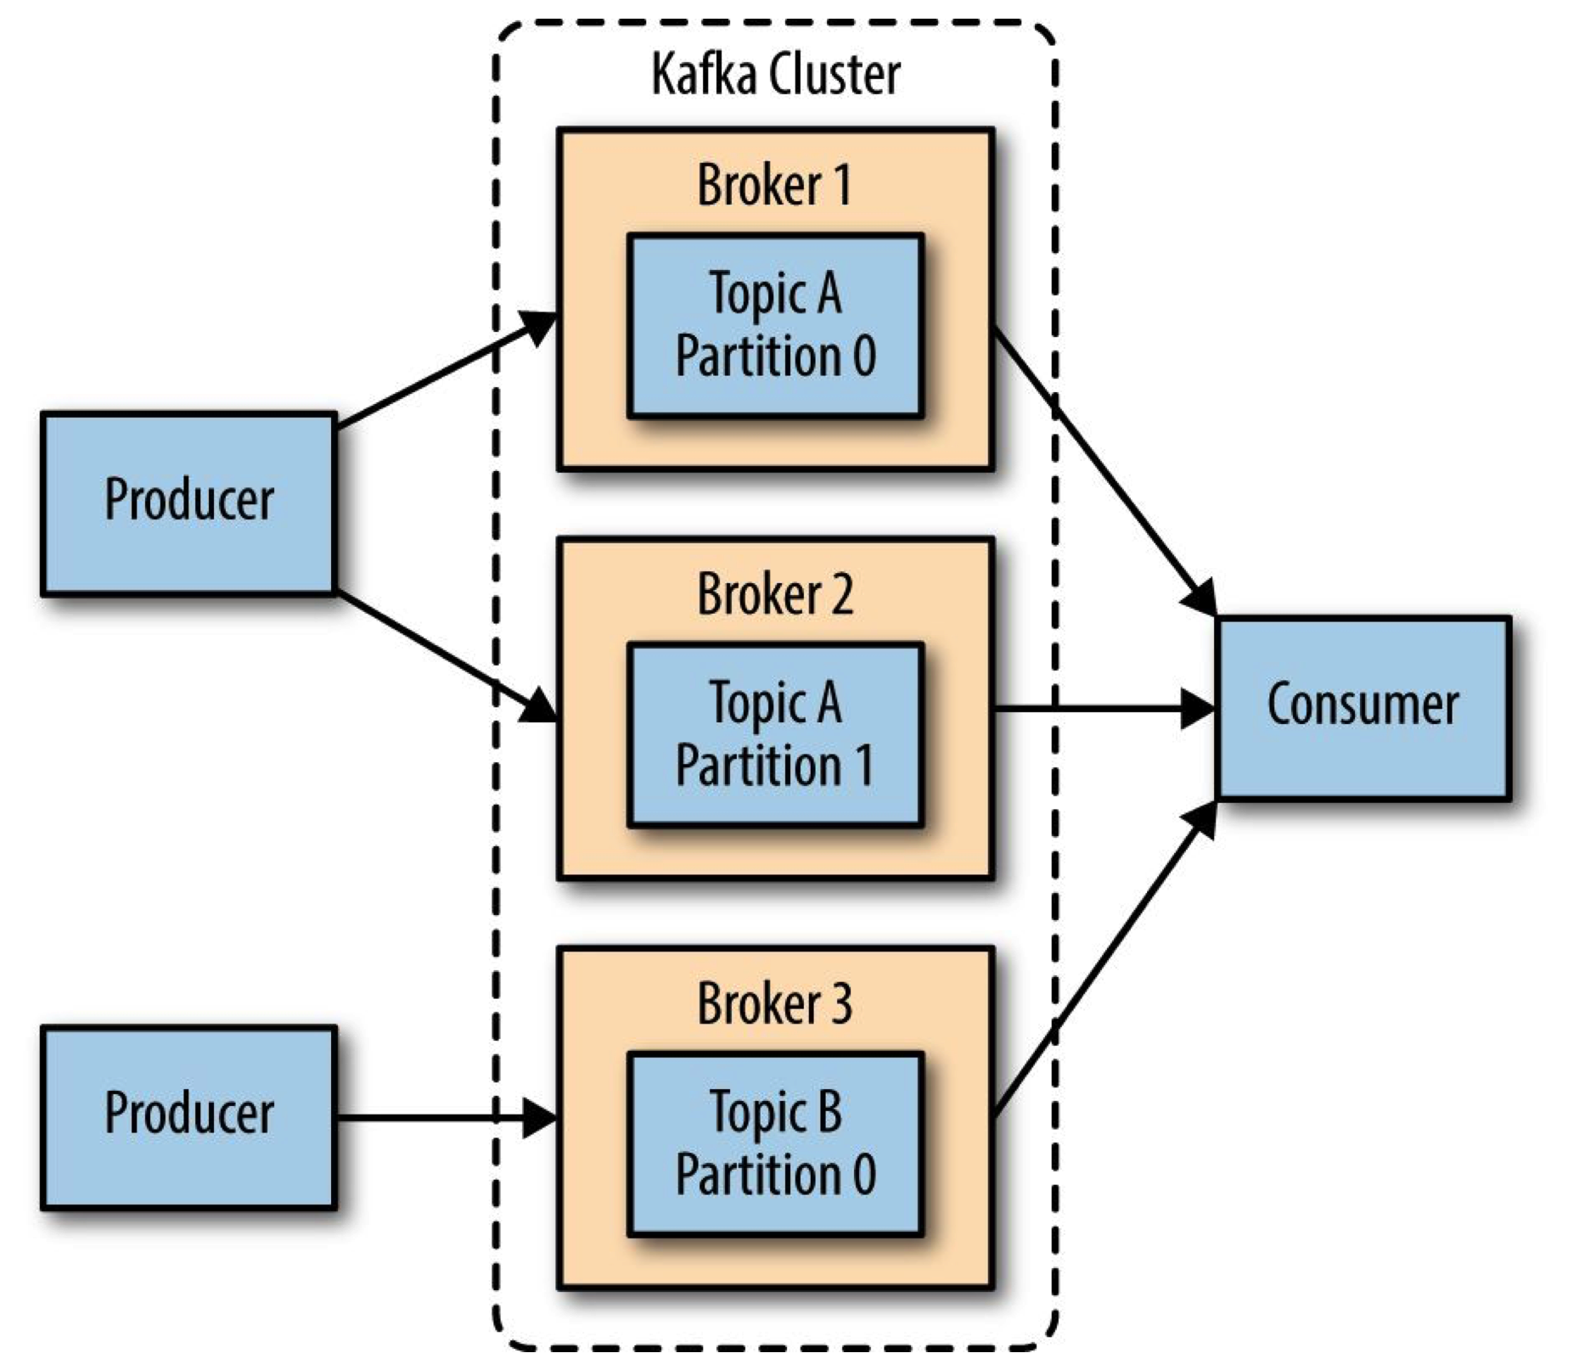
2 – Kafka – Cluster components

Slide 19
2 – Kafka - Terminology
Records
have a key (optional), value and timestamp; Immutable
Topic
is a stream of records (“/email_sent”, “/user_signups”, etc)
Topic Log
is the storage for messages for a topic. It consist of Partitions
and spread to multiple files on multiple nodes.
Partition
parts of Topic Log
Producer API
is used to produce a stream or records
Consumer API
is used to consume a stream of records

Slide 20
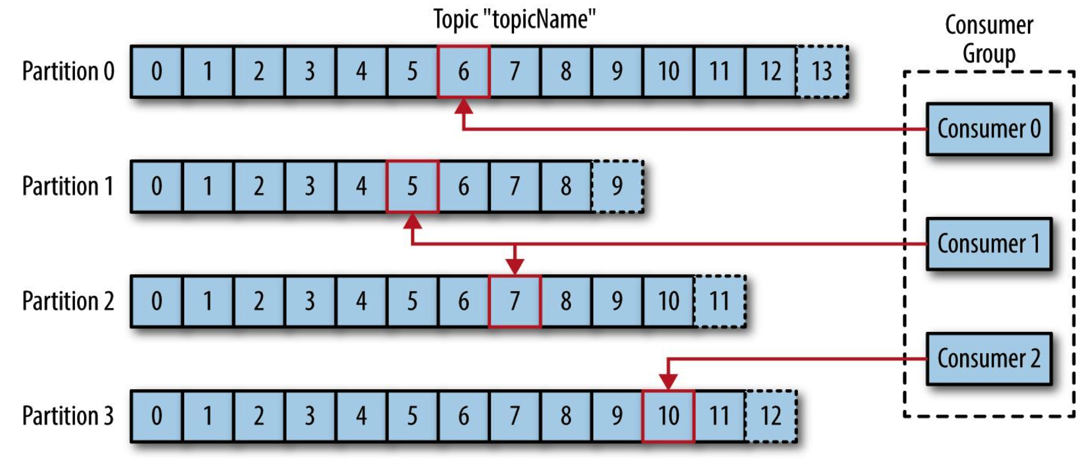
2 – Kafka - Consumption

Slide 21
2 – Kafka - Terminology
Brokers
are Kafka workers and run in a Kafka Cluster.
ZooKeeper
System that coordinates brokers/cluster operation and leadership election
Records
have a key (optional), value and timestamp and are Immutable
Producers
write to Topics
append records at end of Topic log
Consumers
read from Topics
can read from Kafka at their own pace
tracks offset from where they left off reading

Slide 22
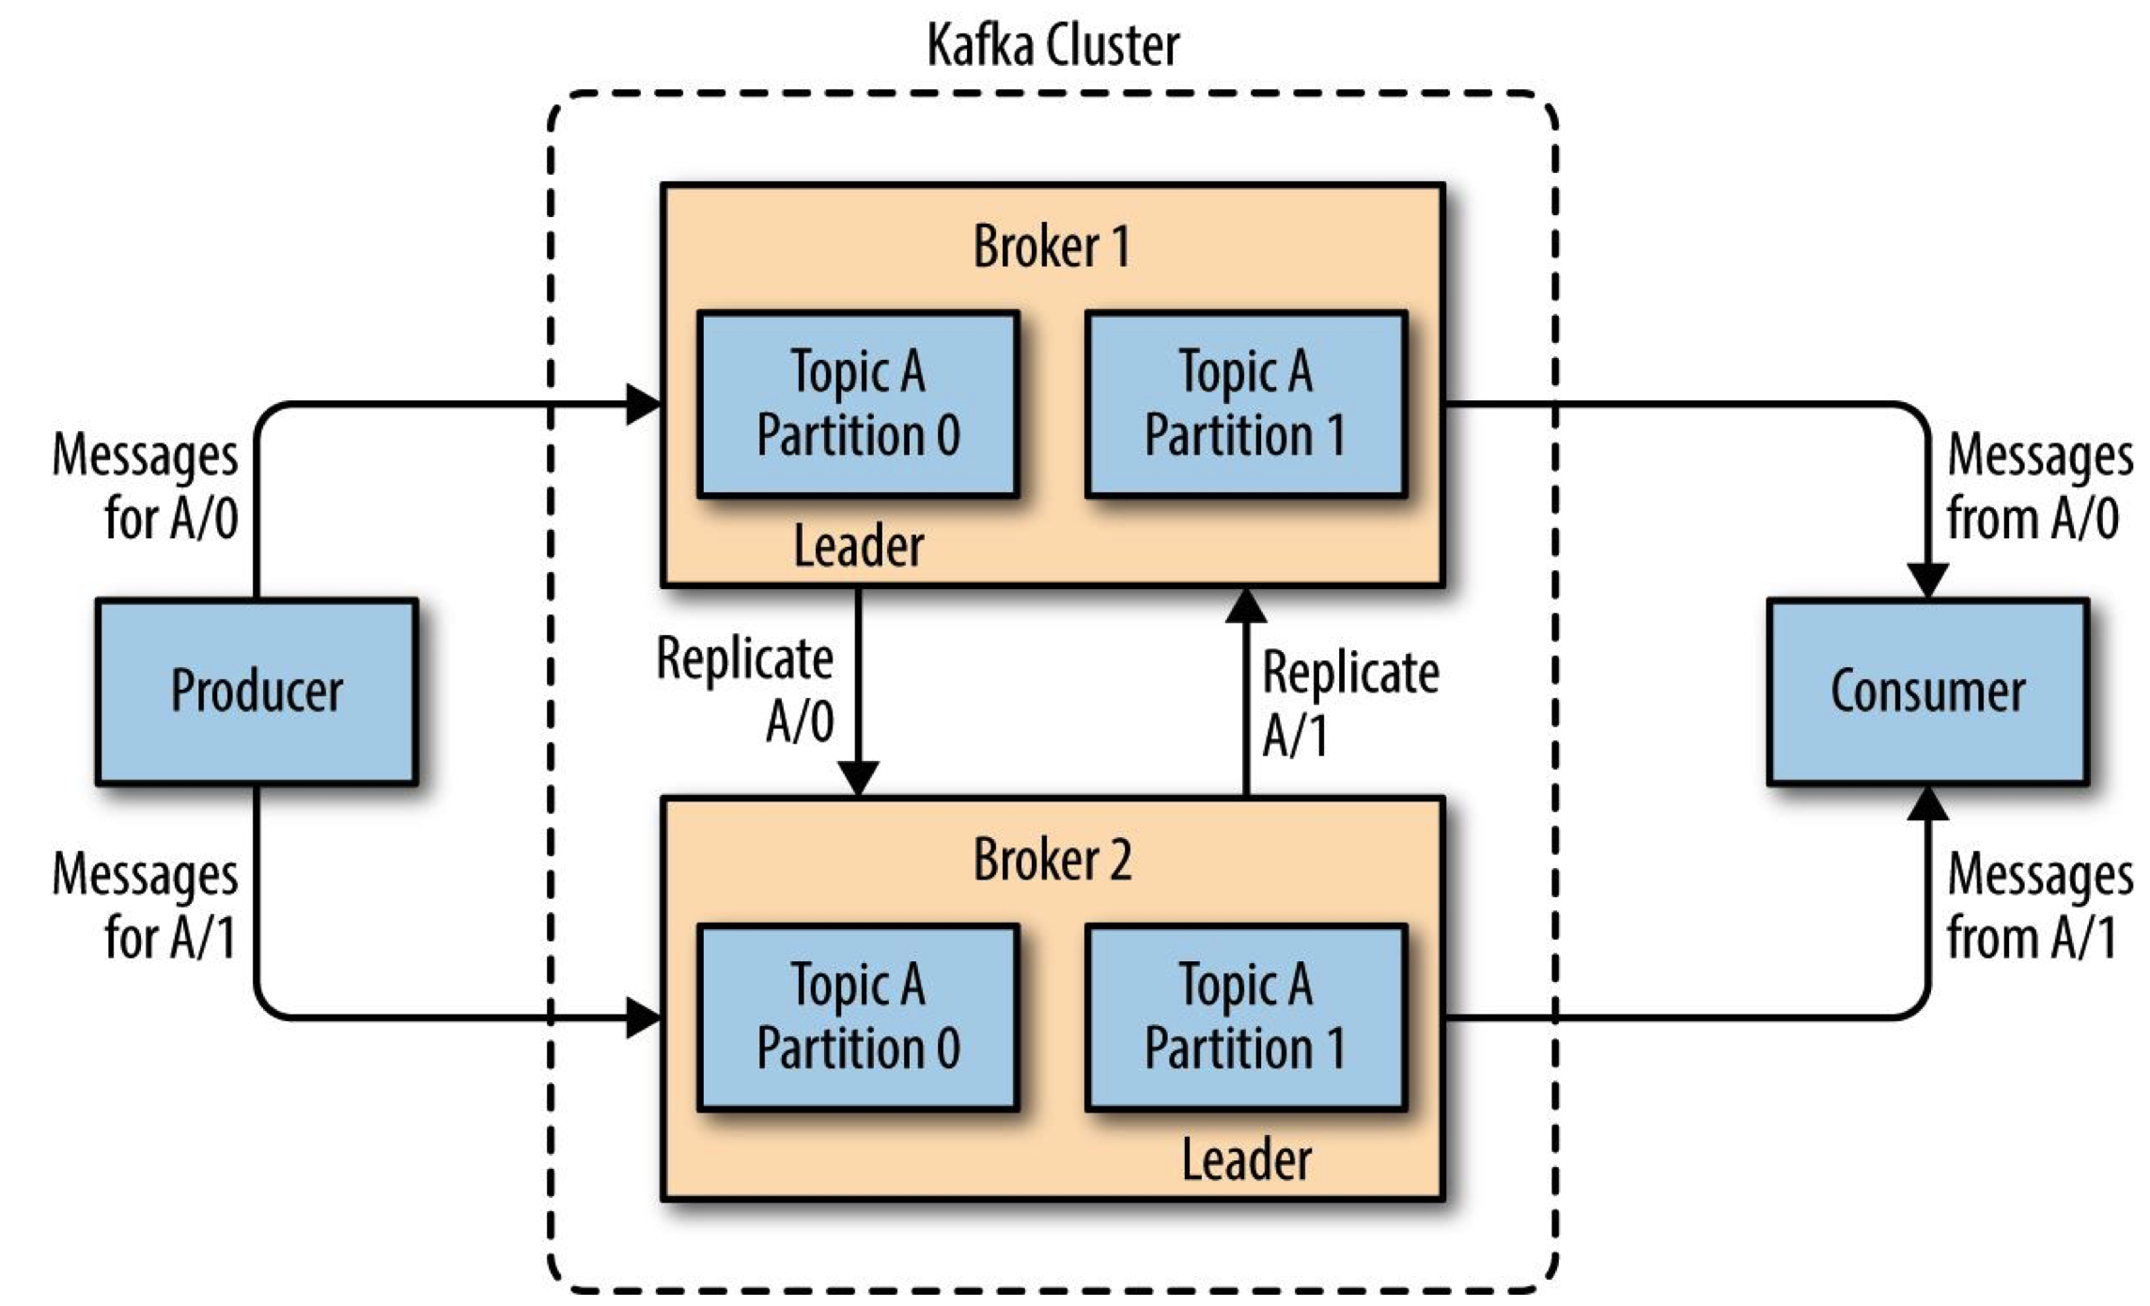
2 – Kafka Topic Partitions

Slide 23
2 – Kafka Partitions and offsets.
- Order is maintained only in a single partition
- A partition is ordered, immutable sequence of records that is
continually appended to a commit log.
- records in partitions are assigned sequential id number called the offset
- Offset identifies each record within the partition
- A topic partition must fit on the server that host it
- A topic can span many partitions hosted on many servers

Slide 24
2 – Kafka vs Aws Kinesis
- Kinesis Streams is equivalent to Kafka Core
- Kinesis Analytics is equivalent to Kafka Streams
- Kinesis Shard is equivalent to Kafka Partition
- Kinesis Analytics allows you to perform SQL like queries on data streams
- Kafka Streaming allows performing functional aggregations and mutations
- Kafka integrates well with Spark and Apache Flink which allows SQL like queries on streams

Slide 25
3 - Bloom Filters
Bloom filters are tools used in and architectures that allow us to statistically reduce the times we execute an ‘expensive’ operation for a particular key.
For example:
Let’s say that I need to perform a left join of a USER table with SUBSCRIBER table. Both tables are huge and have a small number of keys that match both tables.
I can create a Bloom Filter with the keys from one table and save to a file. Then this file is distributed across the nodes and I can ask if the filter “have seen” a particular key.

Slide 26
Uses of Bloom Filters in the industry
(source Wikipedia)
Online Services: Akamai's web servers use Bloom filters to prevent "one-hit-wonders" from being stored in its disk caches. One-hit-wonders are web objects requested by users just once.
Software tools: Google Bigtable, Apache HBase and Apache Cassandra, and PostgreSQL use Bloom filters to reduce the disk lookups for non-existent rows or columns. Avoiding costly disk lookups considerably increases the performance of a database query operation.

Slide 27
Bloom Filters (cont. 1)
There are only two possible answers “No” or “Maybe”.
But the rate of errors on the maybe is small and we can control it. Smaller error rates mean larger files.
So, we can easy process all the records with the “No” response and process the “expensive” operation only on the “maybe” records.

Slide 28
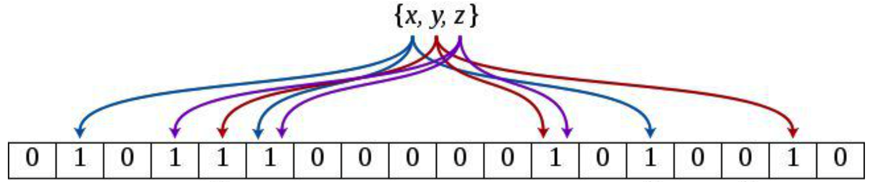
How do Bloom Filters Work?
Building the filter.
Each key inserted change bits in some locations to ‘1’

Slide 29
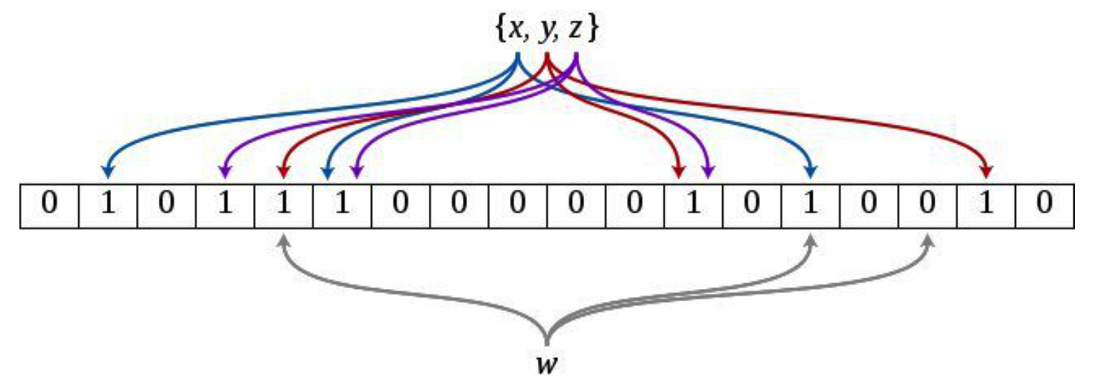
How do Bloom Filters Work?
When the keys x,y,z are inserted they change the bits of the filter to ‘1’
in some specific locations

Slide 30
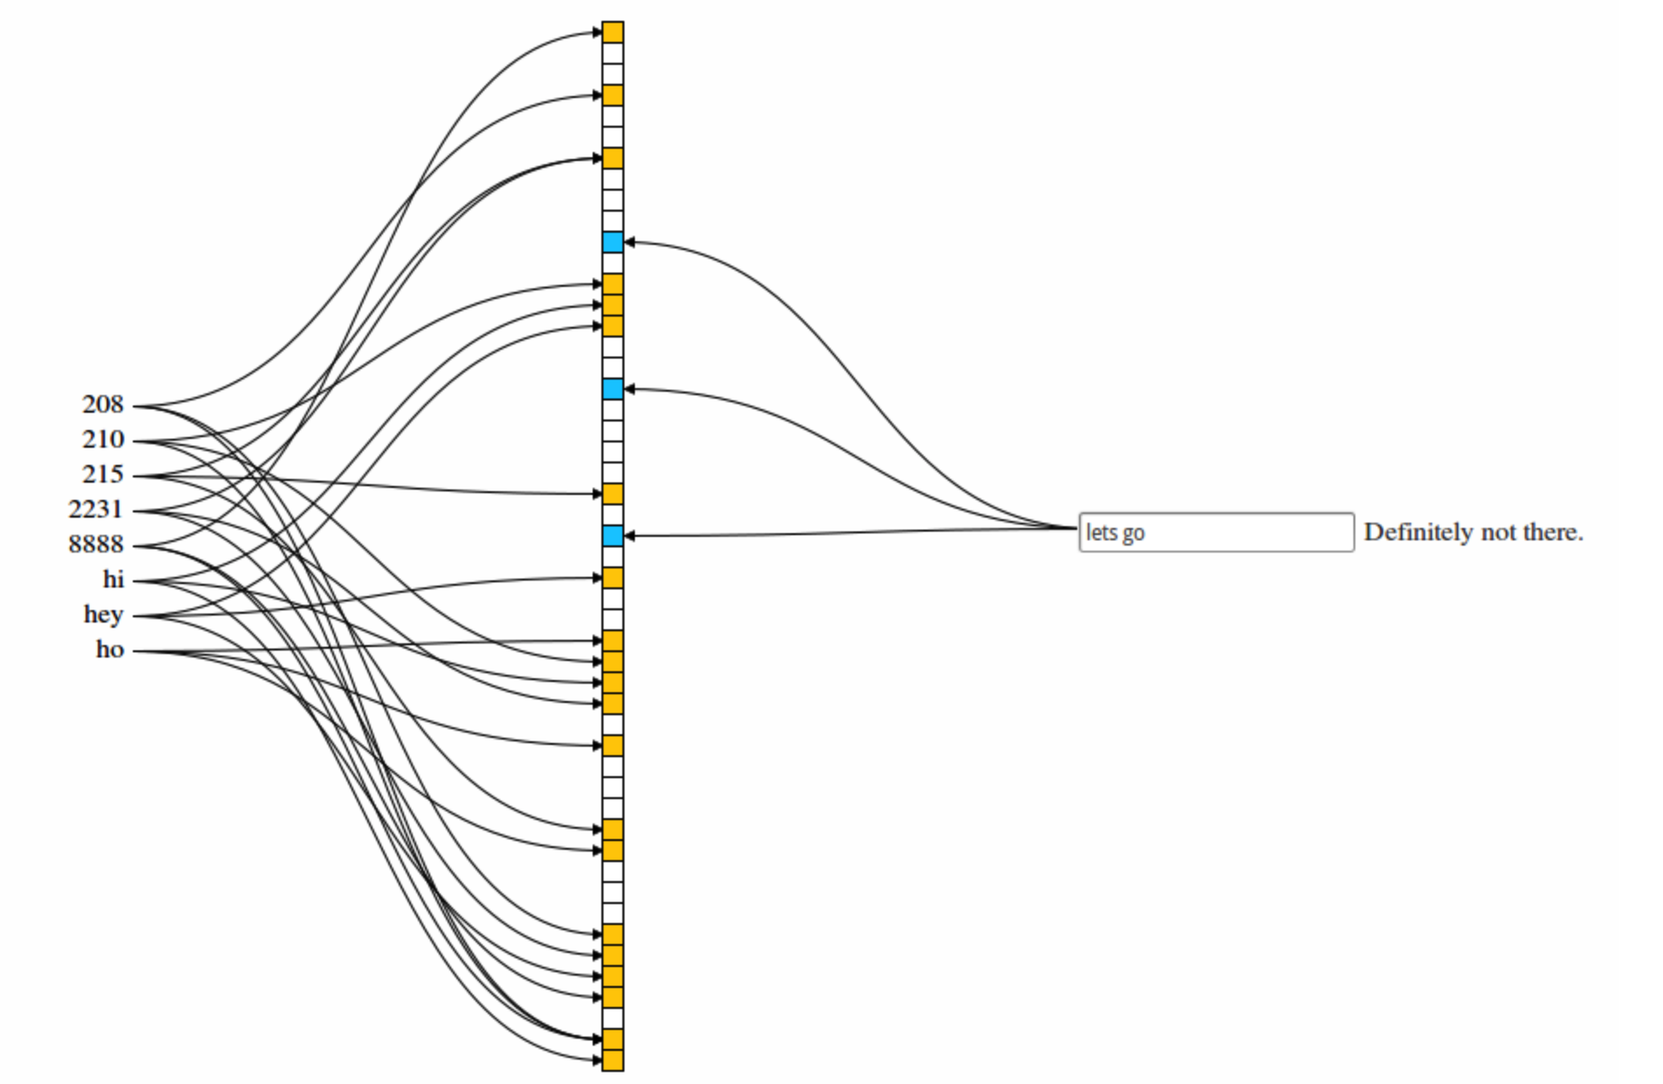
How to Bloom Filters Work
A Bloom filter contain a large array of bits.
Add a new key to the Bloom filter.
1. Each key is passed to several
hash functions.
2. Calculate the mod <array size> of
the values returned by the hash
functions.
3. Set each ‘bit’ to 1.

Slide 31
How to Bloom Filters Work (cont. 1)
Find if Key was presented to the
Bloom Filter.
1. Each key is passed to several
hash functions.
2. Calculate the mod <array size> of
the values returned by the hash
functions.
3. Check to see if ALL the bit are ‘1’
- If ‘No’ we can say that the key never
appeared.
- If all bit are ‘1’ then we have
two options:
- A combination of keys set the bits
for key we are looking for (maybe)
- The exact key was presented to the
filter.

Slide 32
Q & A

